Slide 1
Freshman RPG Iteration #3
Companion App

Slide 2
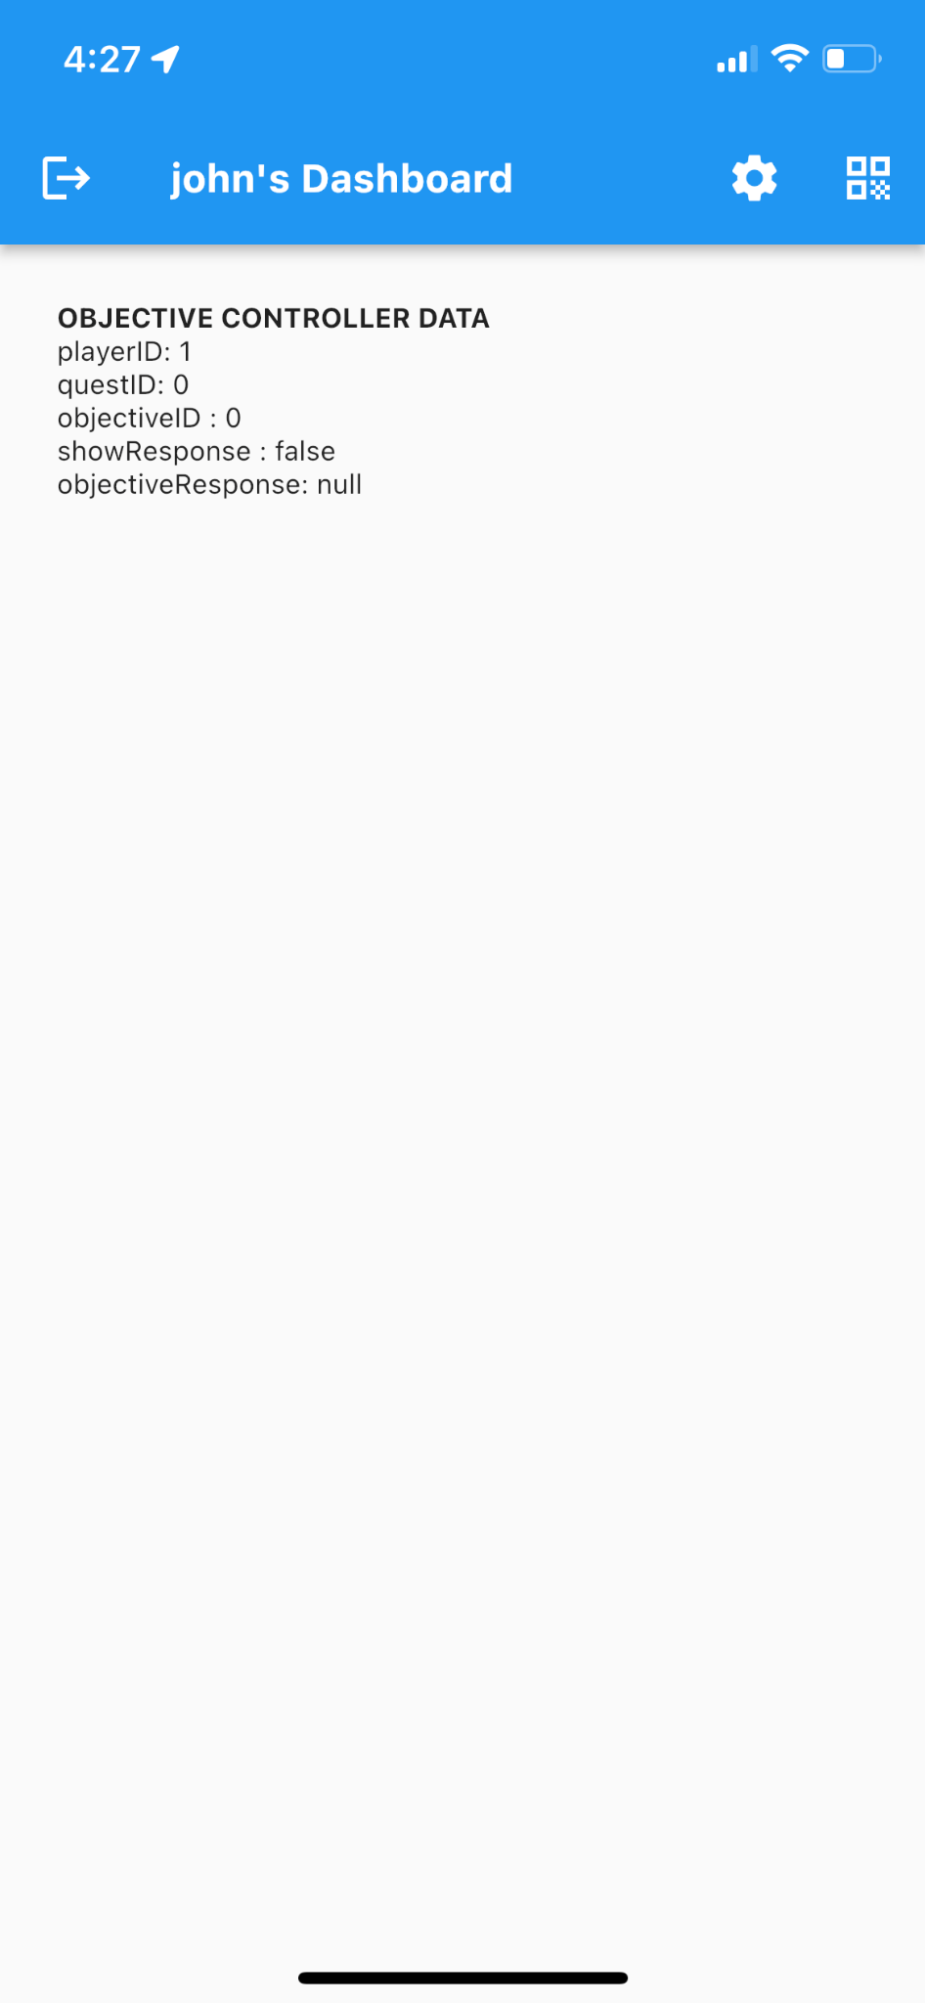
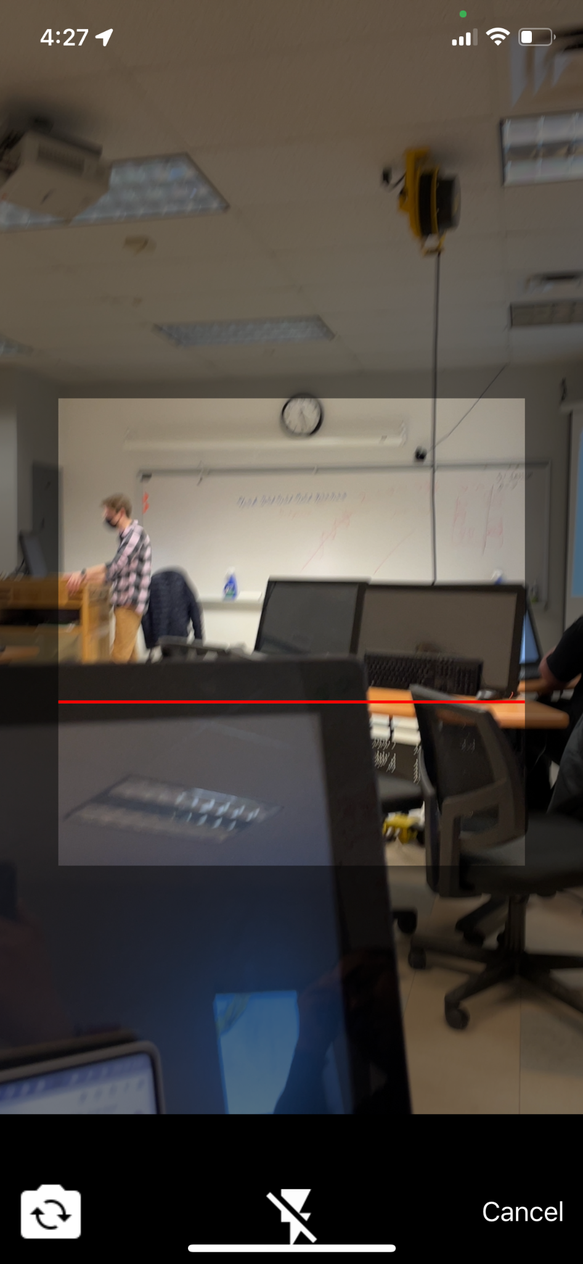
Story 1: Users can scan QR code to complete objectives
A button was added to the top right of the screen
This will open the QR view for reading QR code

Slide 3
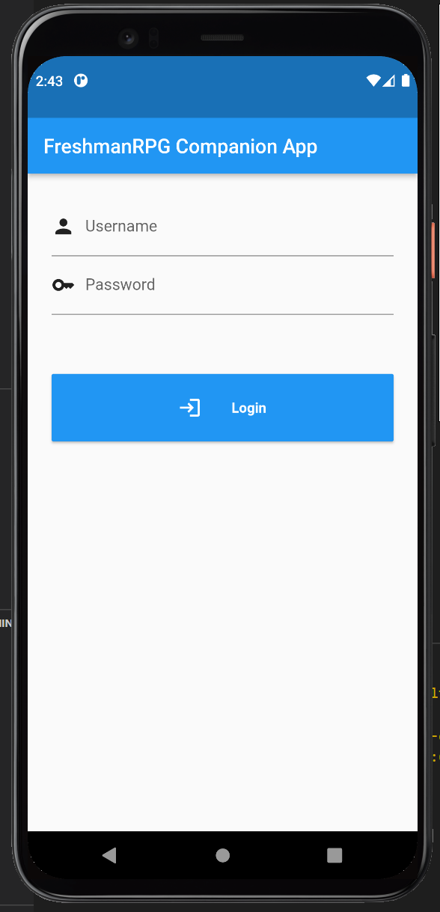
Story 2: Users can login
By entering a players username and password you can access the app

Slide 4
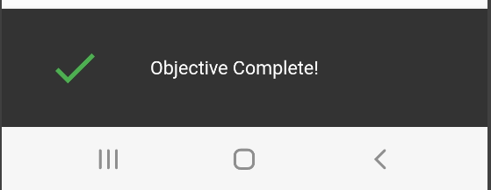
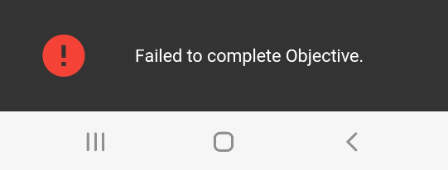
Story 3: User can see when the objective completion is finished processing
After scanning a QR a pop-up will appear displaying the status of the request

Slide 5
What We Can Do in the Future
GPS Location
App icon
In-app Quest Log

Slide 6
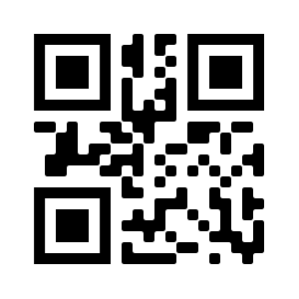
Time for a demo

Slide 7
Any Questions?

